Slide 1
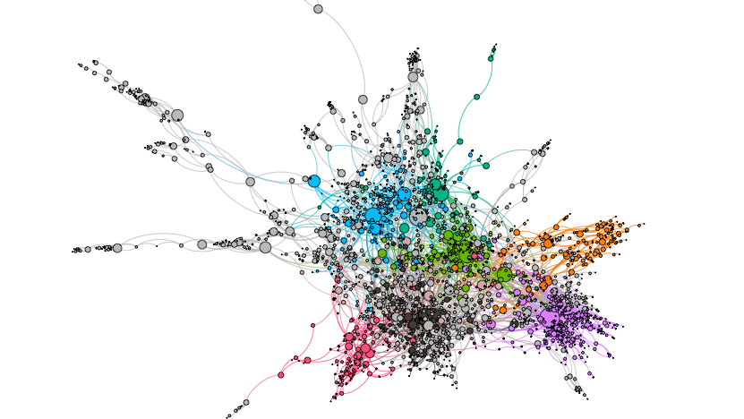



Graph and geometric
deep learning
Presenters: Simone Scardapane, Indro Spinelli
Enel Third Global Data Meet Up, April 22nd 2021
Notes:
email alla fine

Slide 2
Introduction
On the importance of graphs in
deep learning

Slide 3
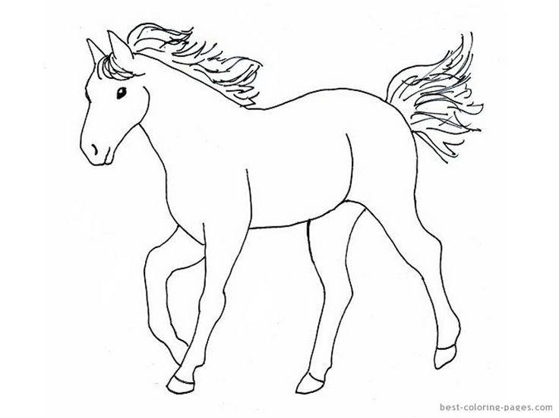
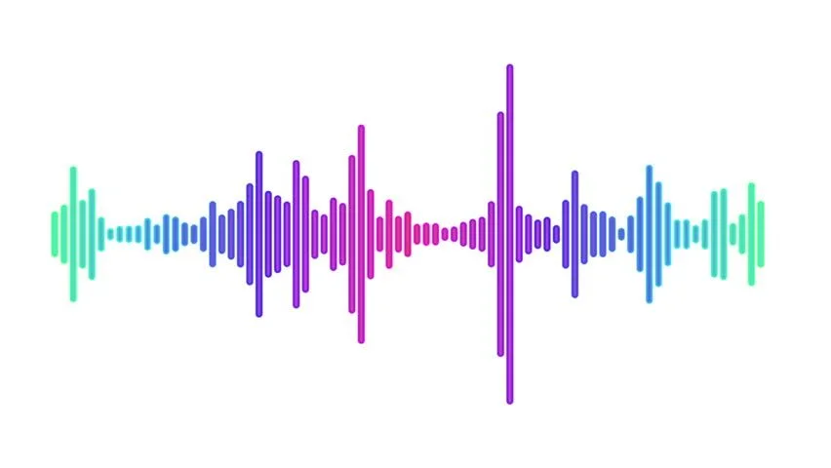
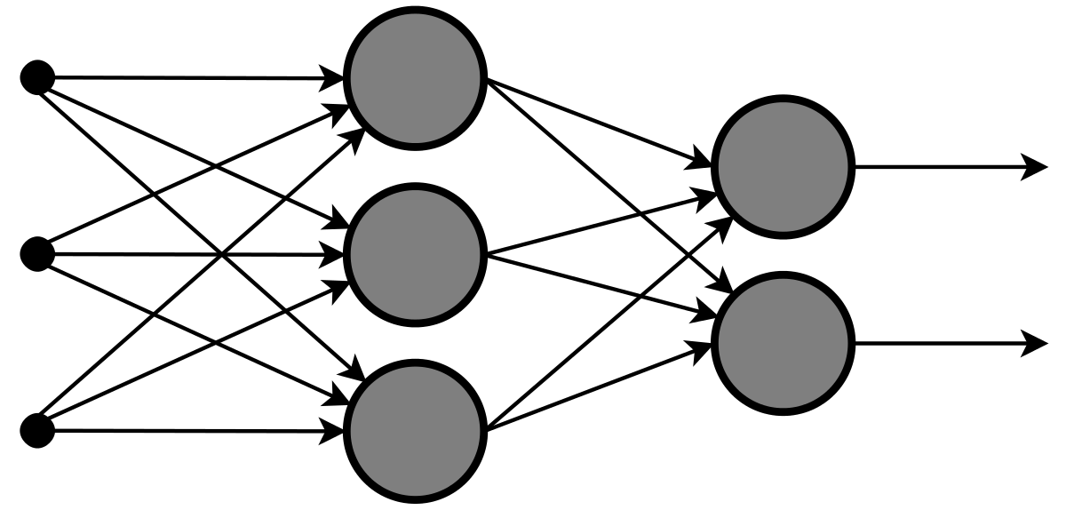
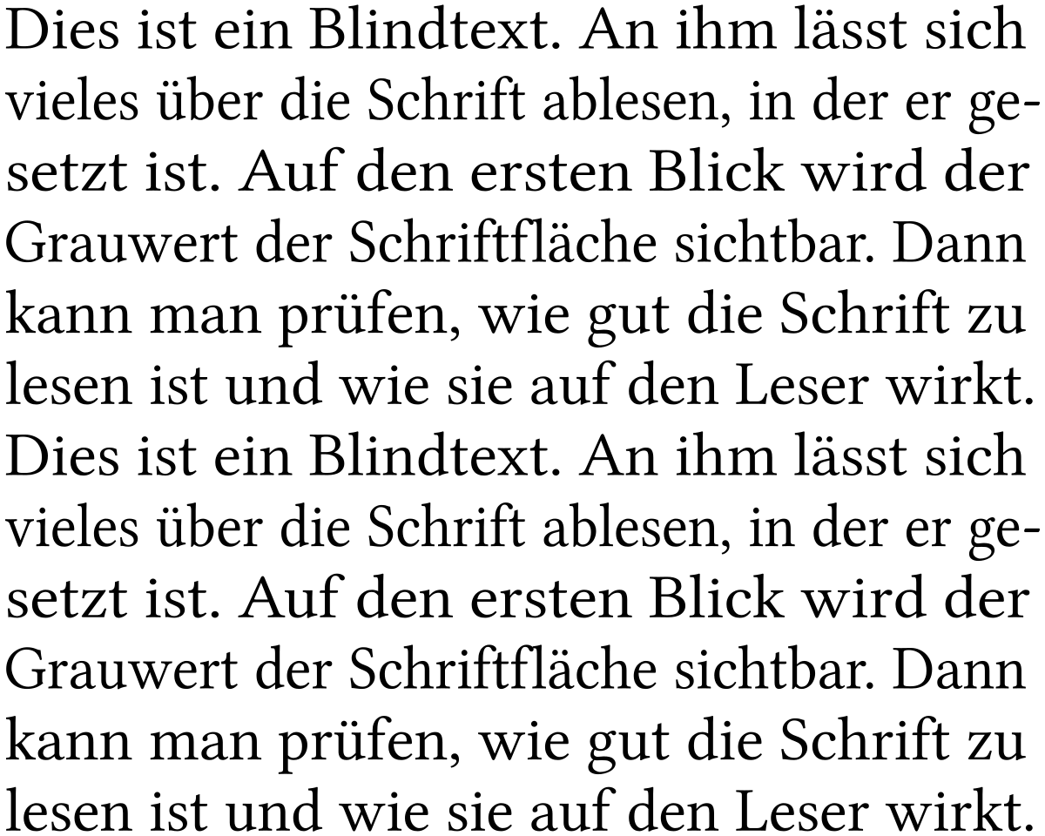
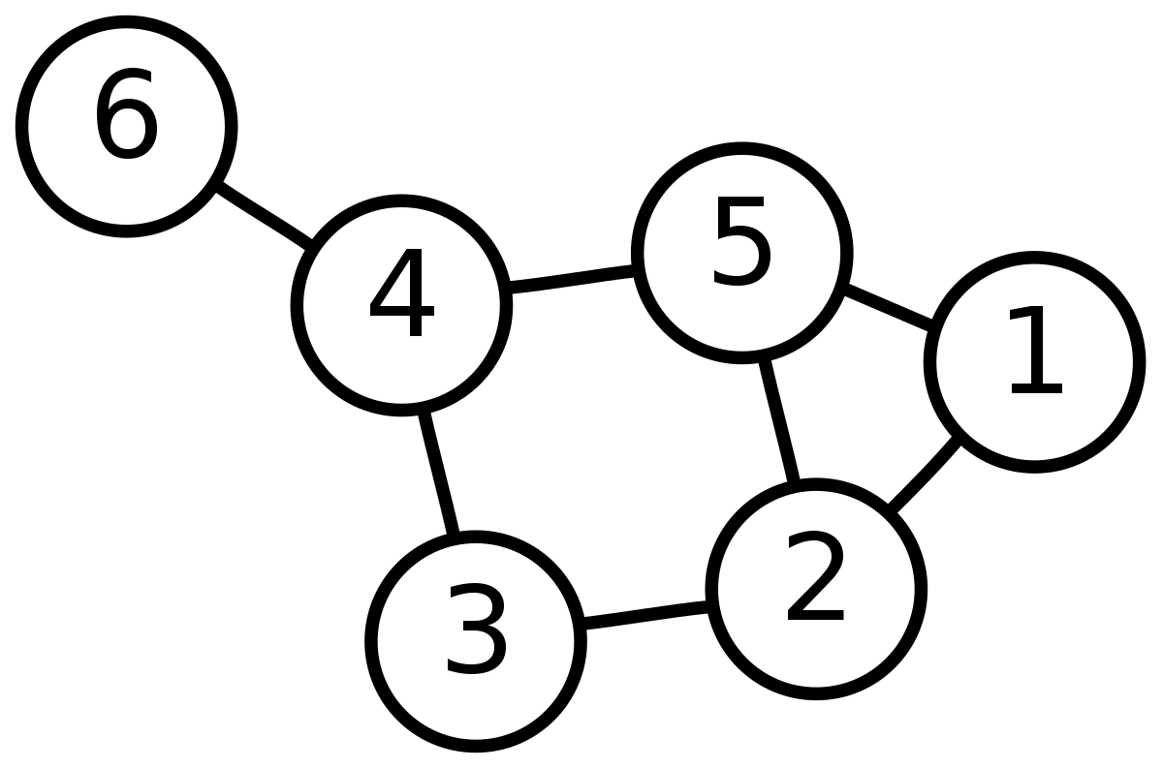

Data ingestion in deep learning
WaveNet, Wav2Vec, ...
Audio
Images
CNNs, Vision Transformers, ...
Texts
???
Graphs
Word embeddings, Transformers, ...

Slide 4
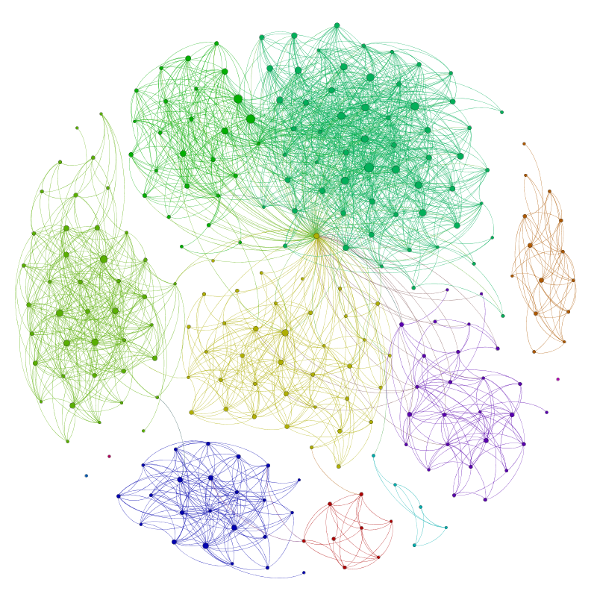
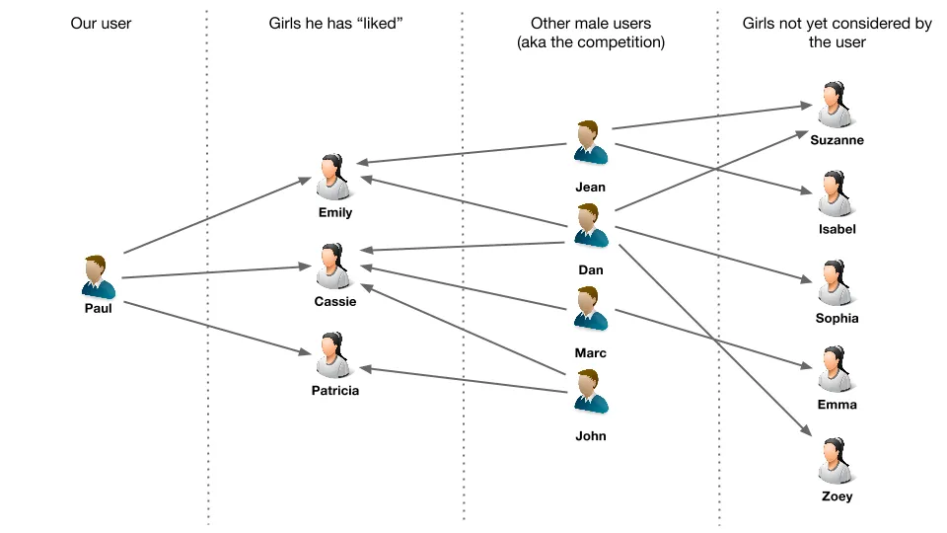
Graphs are everywhere (1/4)
https://linkurio.us/blog/using-neo4j-to-build-a-recommendation-engine-based-on-collaborative-filtering/
http://allthingsgraphed.com/2014/08/28/facebook-friends-network/

Slide 5
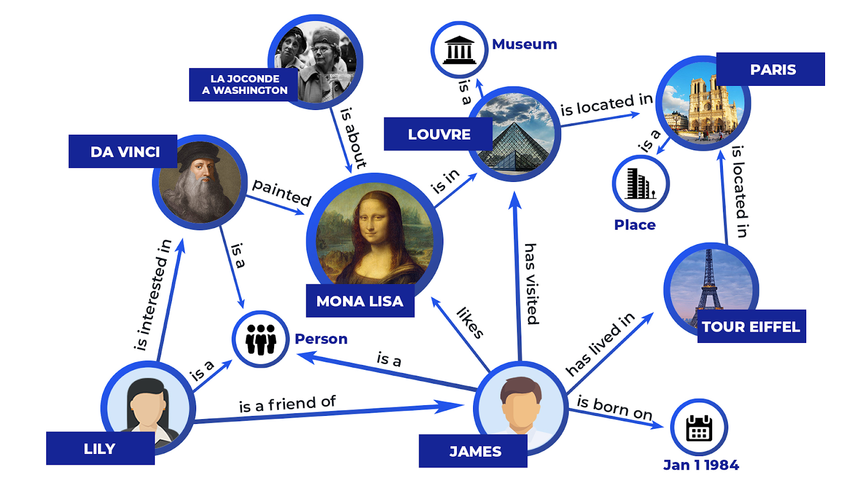
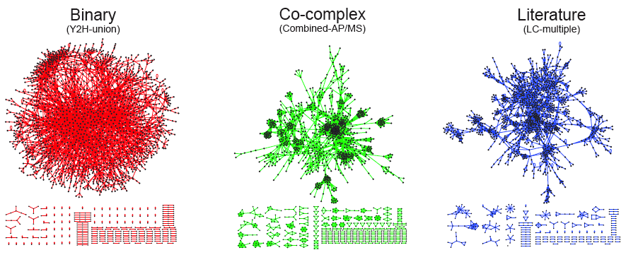
Graphs are everywhere (2/4)
http://snap.stanford.edu/deepnetbio-ismb/ipynb/Graph+Convolutional+Prediction+of+Protein+Interactions+in+Yeast.html

Slide 6
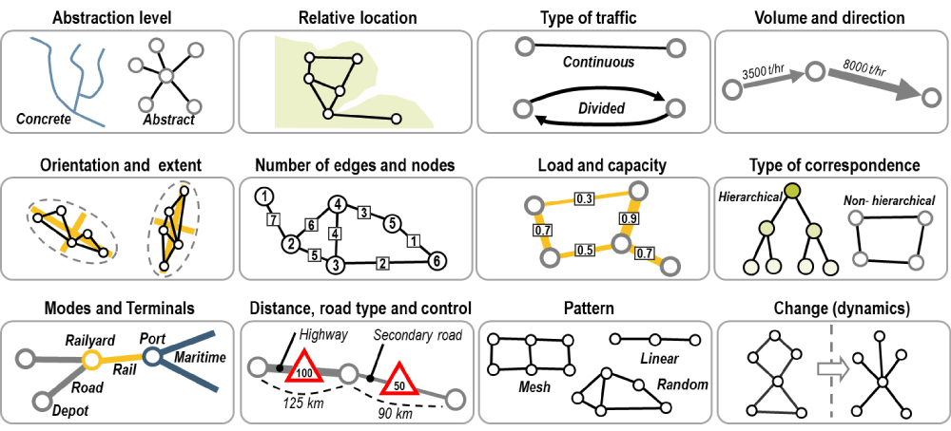
Graphs are everywhere (3/4)
https://transportgeography.org/?page_id=719

Slide 7
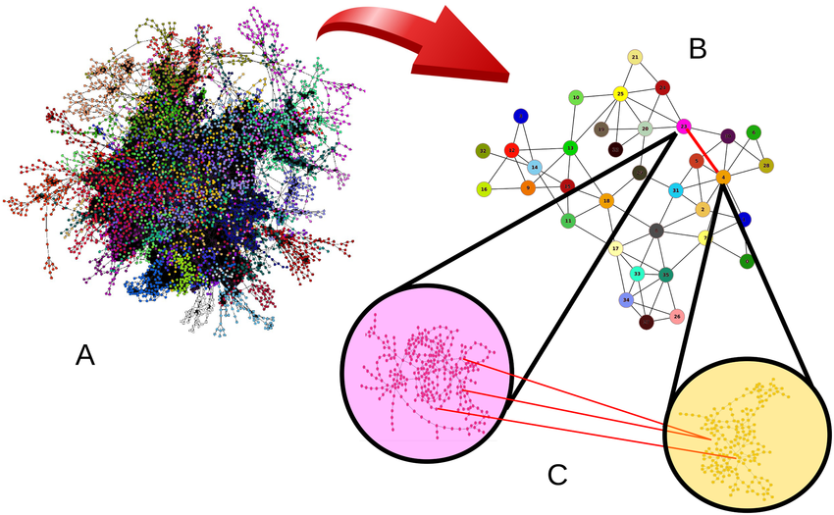
Graphs are everywhere (4/4)
Fast Fragmentation of Networks Using Module-Based Attacks

Slide 8
Graph and learning
Machine learning on graphs

Slide 9
What is a graph?
Other graphs!
Edge
Friendships, citations, proximity, ...
Edge features
Category, time-stamps, ...
Node features
Vertex
Vectors, word embeddings, ...
Users, texts, sensors, ...

Slide 10
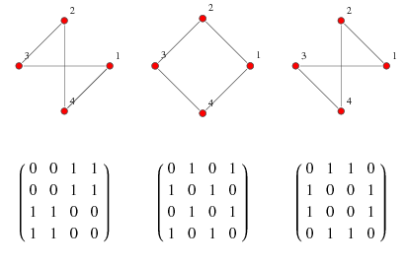
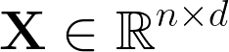
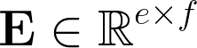
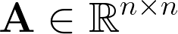
Graphs are (represented by?) matrices
Node features
each node has d features
Edge features
Adjacency matrix
each edge has f features
n vertices in the graph
Adjacency Matrix -- from Wolfram MathWorld

Slide 11
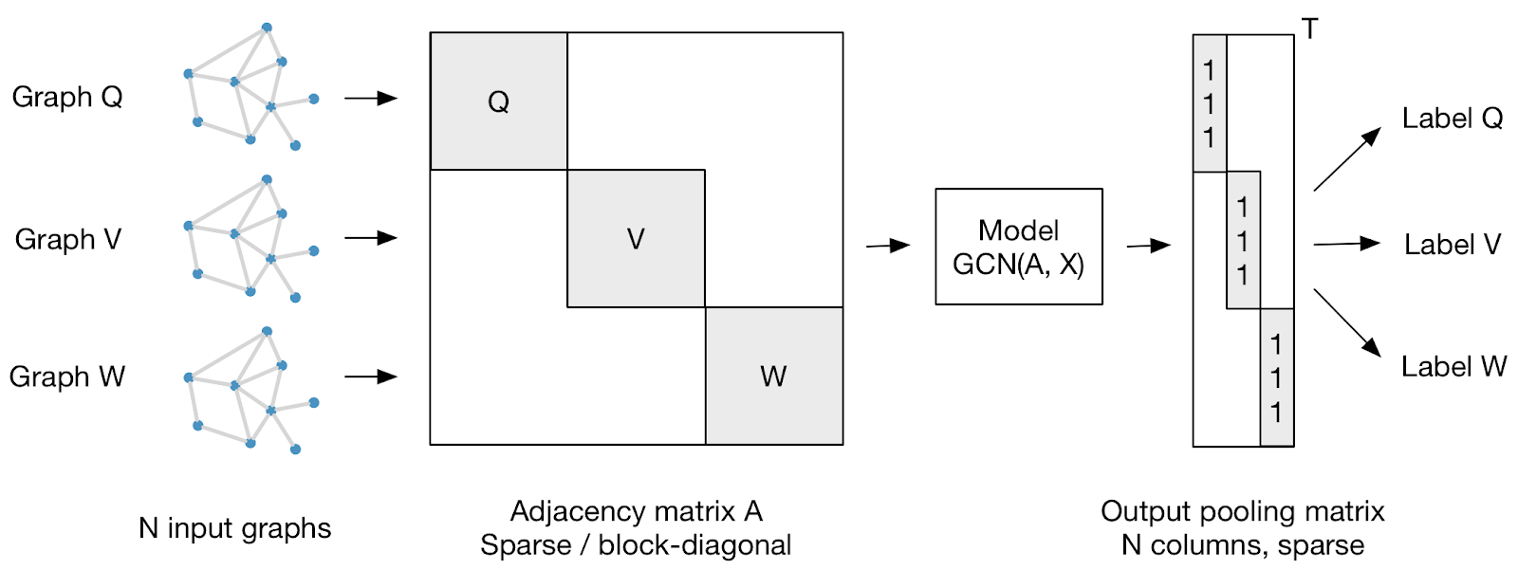
Scaling up and batching
tkipf/gcn: Implementation of Graph Convolutional Networks in TensorFlow

Slide 12
What can we learn on a graph?
Edge classification
Graph classification
Graph generation
Edge completion
Graph summarization
Node classification

Slide 13
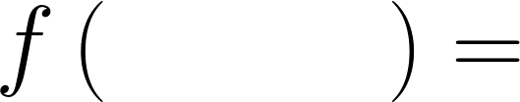
How can we learn on a graph?
We want to do deep learning, hence f should be differentiable, composable, scalable.

Slide 14
Graph and learning
Defining a graph layer

Slide 15
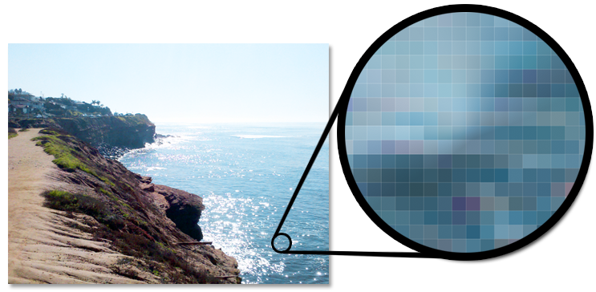
Deep learning is about leveraging structure
Generate cross-stitch patterns from any image.

Slide 16
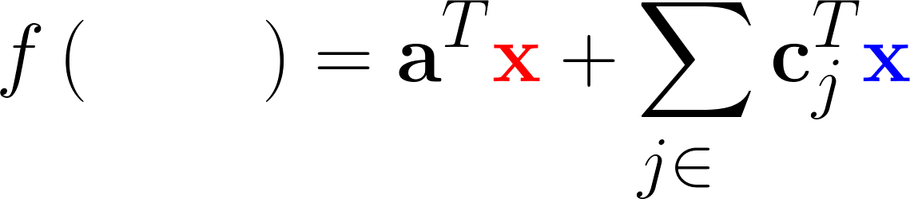
Image convolutions
Local pixel operation
Neighbour pixel operation
Aggregation

Slide 17
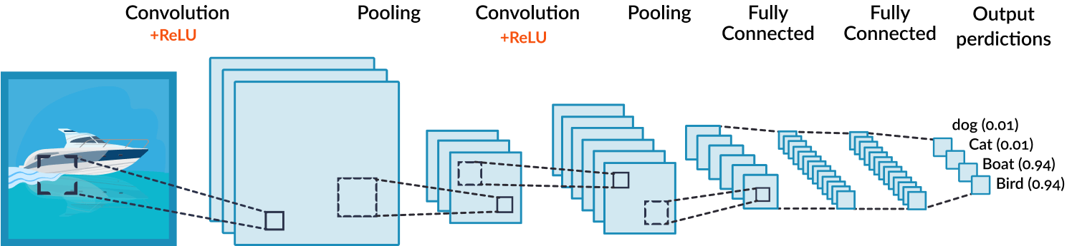
Convolutional neural networks
Convolutional Neural Network Tutorial: From Basic to Advanced

Slide 18
Images vs. graphs
How much of the structure of an image do we find in graphs?
Locality (neighbourhood).
Fixed number of neighbours.
Neighbours have a definite ordering.
✔️
❌
❌

Slide 19
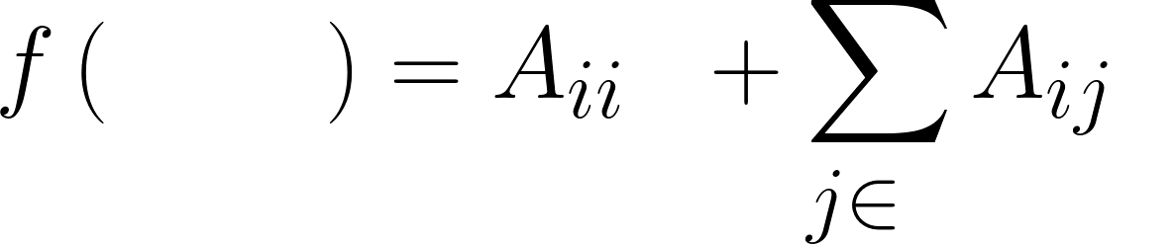
Graph convolutions
Local vertex operation
We use the adjacency matrix
(or similar)
Note: the mixing coefficients are no more learnable! Here, only local operations are trainable.

Slide 20
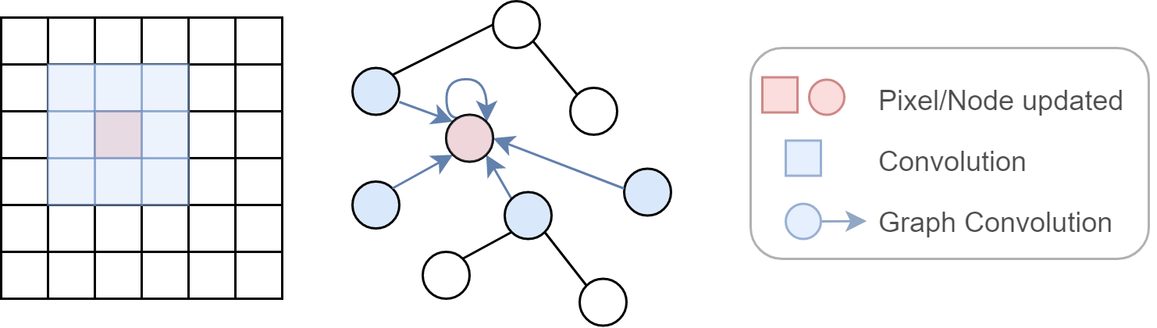
Graph convolution visualized
https://spindro.github.io/post/gnn/

Slide 21
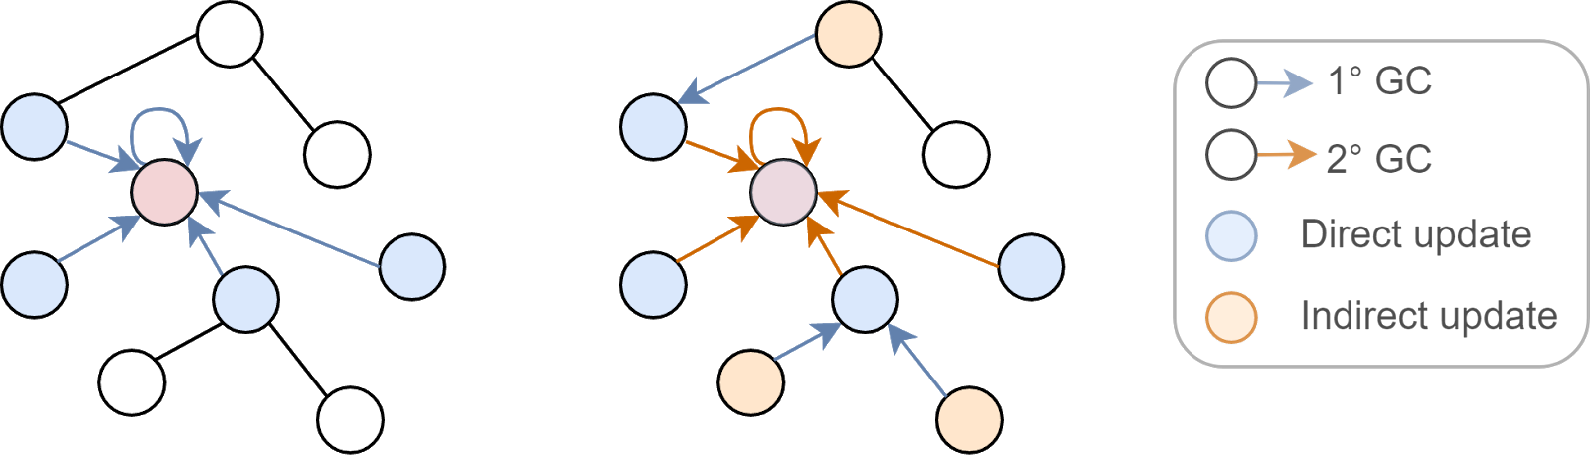
Stacking graph convolutional layers
Performing multiple updates increases the “receptive field” of each node.
https://spindro.github.io/post/gnn/

Slide 22
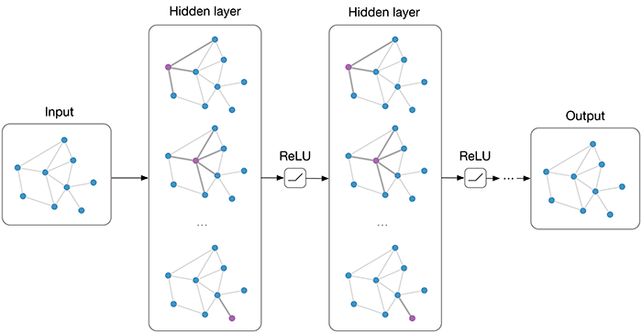
Visualizing a graph convolutional network
Kipf, T.N. and Welling, M., 2016. Semi-supervised classification with graph convolutional networks. arXiv preprint arXiv:1609.02907.

Slide 23
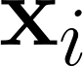
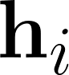
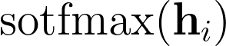
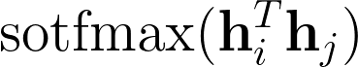
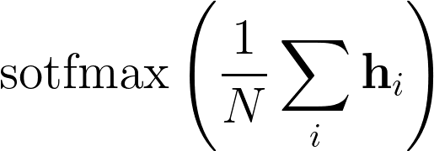
Tackling multiple tasks
Node classification:
Edge classification:
Graph classification:

Slide 24
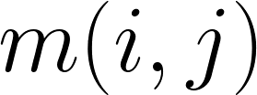
Message-passing neural networks
Instead of using directly the adjacency matrix, nodes can exchange messages with several mechanisms (e.g., attention models).
Gilmer, J., Schoenholz, S.S., Riley, P.F., Vinyals, O. and Dahl, G.E., 2017, July. Neural message passing for quantum chemistry. In International Conference on Machine Learning (pp. 1263-1272). PMLR.

Slide 25
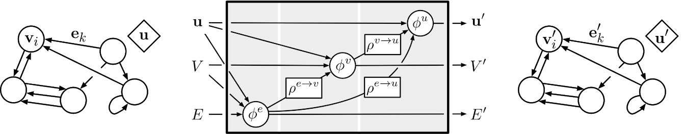
A more general setup
Battaglia, P.W., Hamrick, J.B., Bapst, V., Sanchez-Gonzalez, A., Zambaldi, V., Malinowski, M., Tacchetti, A., Raposo, D., Santoro, A., Faulkner, R. and Gulcehre, C., 2018. Relational inductive biases, deep learning, and graph networks. arXiv preprint arXiv:1806.01261.

Slide 26
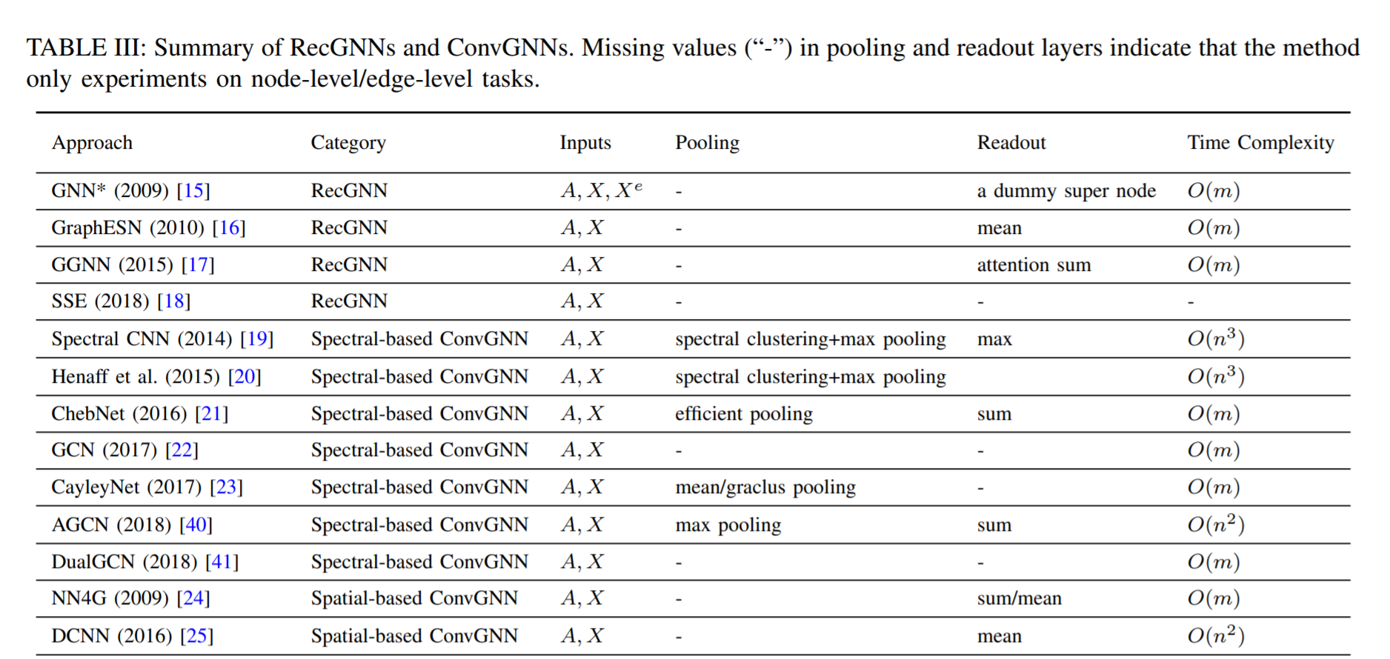
A zoo of techniq ues...
Wu, Z., Pan, S., Chen, F., Long, G., Zhang, C. and Yu, P.S., 2019. A comprehensive survey on graph neural networks. arXiv preprint arXiv:1901.00596.

Slide 27
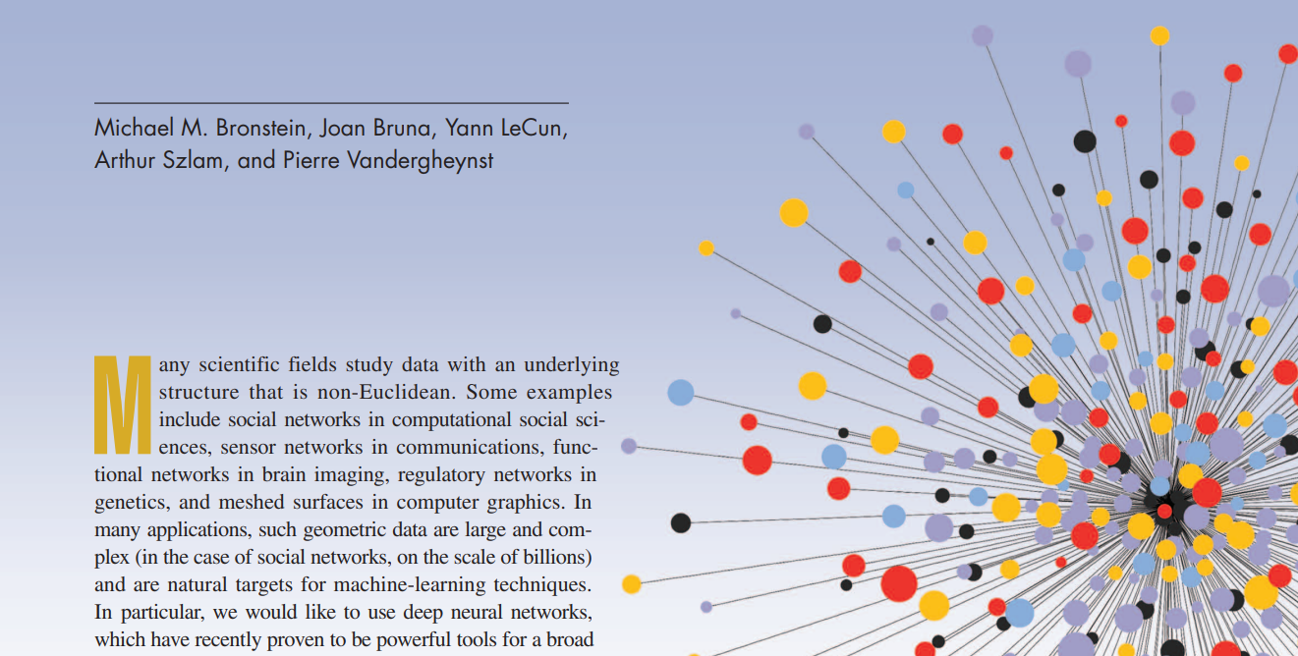
Geometric deep learning
Bronstein, M.M. et al., 2017. Geometric deep learning: going beyond Euclidean data. IEEE Signal Processing Magazine, 34(4), pp.18-42.

Slide 28
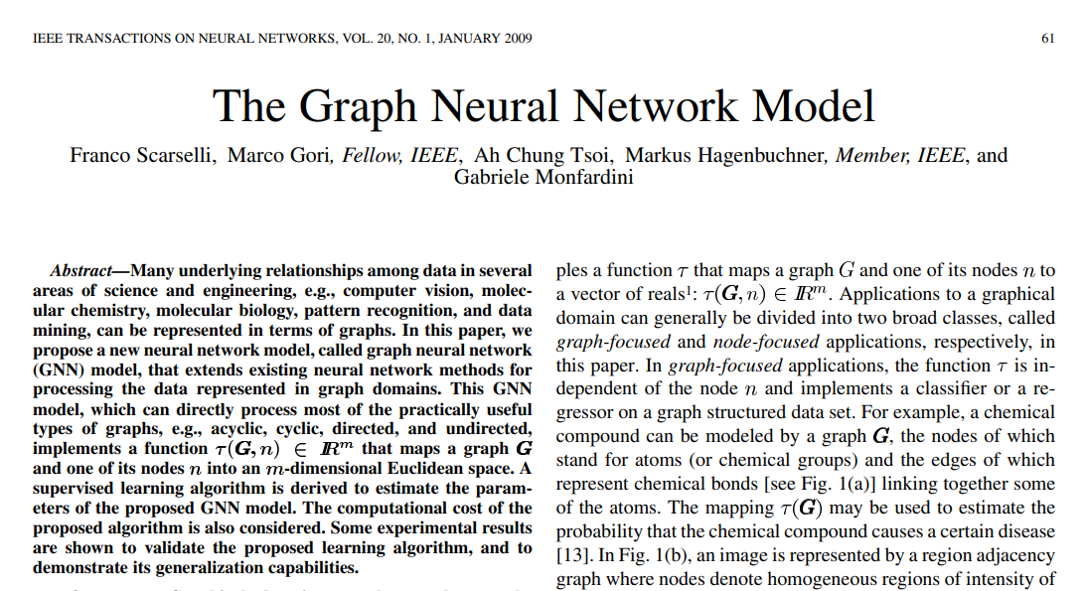
GNNs before deep learning!

Slide 29
Graph and learning
Some famous applications

Slide 30
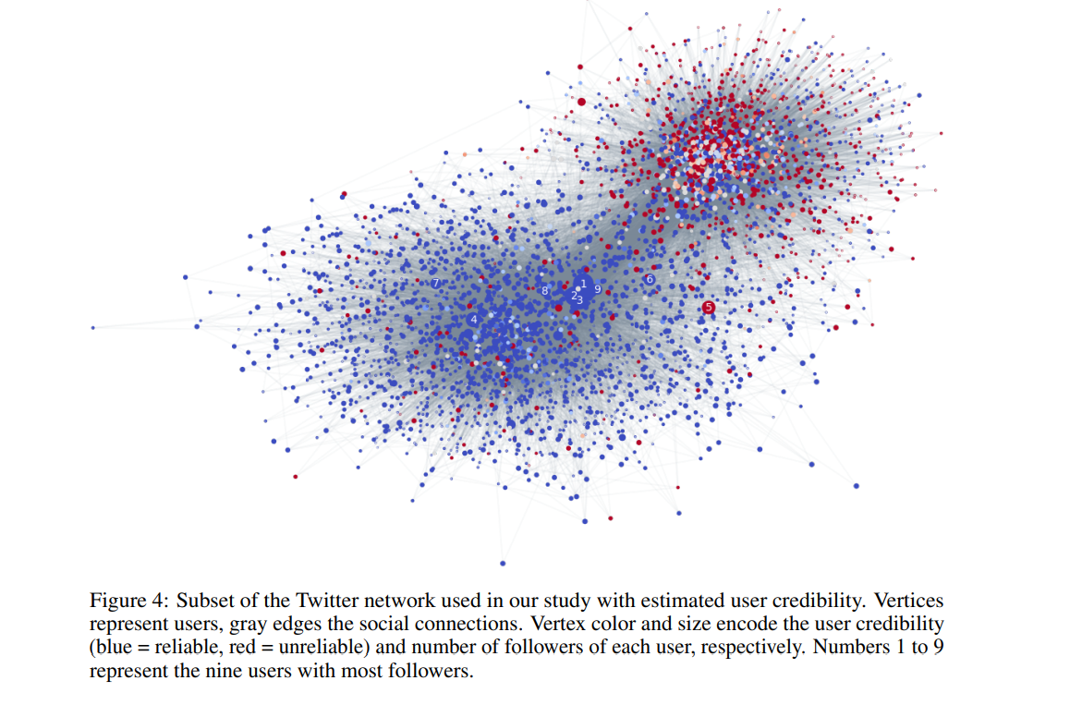
Fake news detection on Twitter
Monti, F., Frasca, F., Eynard, D., Mannion, D. and Bronstein, M.M., 2019. Fake News Detection on Social Media using Geometric Deep Learning. arXiv preprint arXiv:1902.06673.

Slide 31
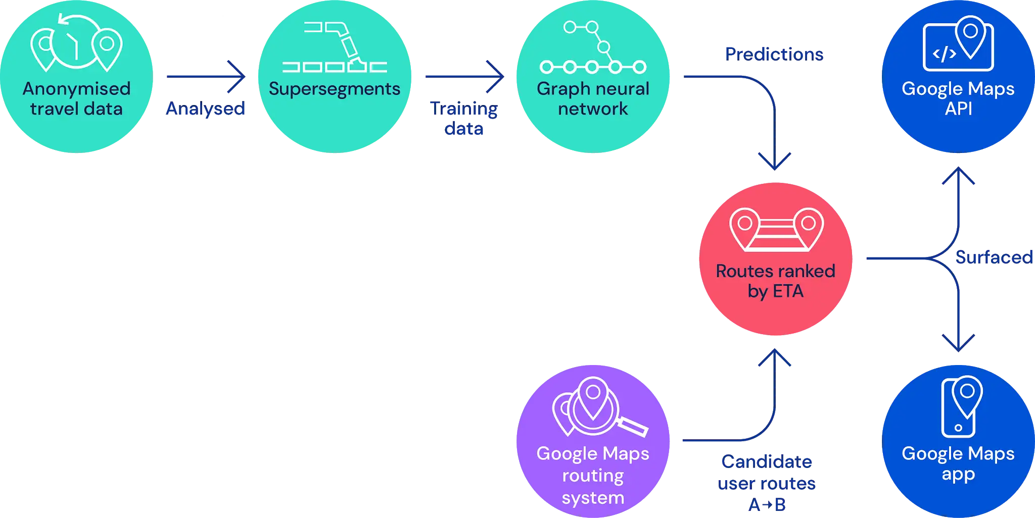
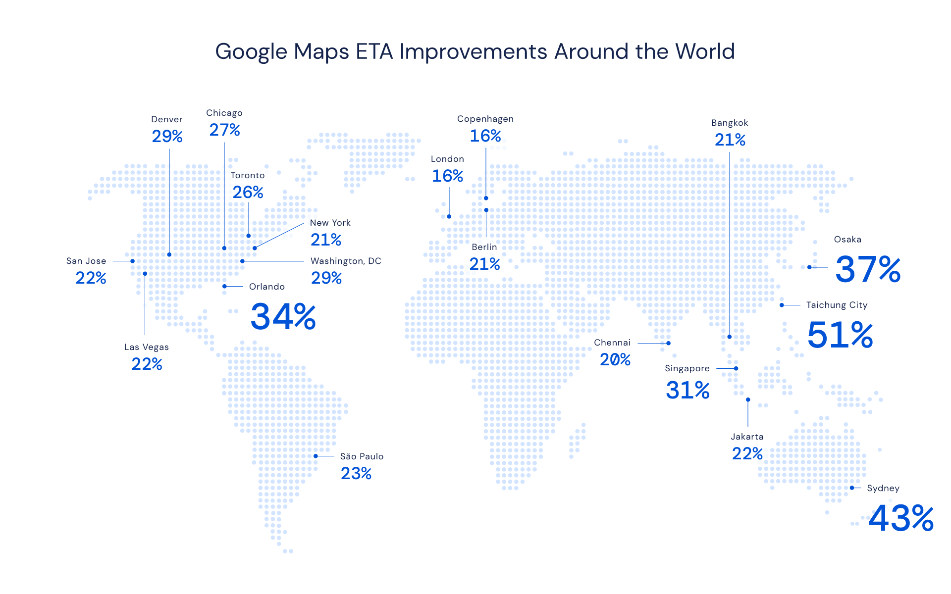
Traffic prediction on Google Maps
Traffic prediction with advanced Graph Neural Networks

Slide 32
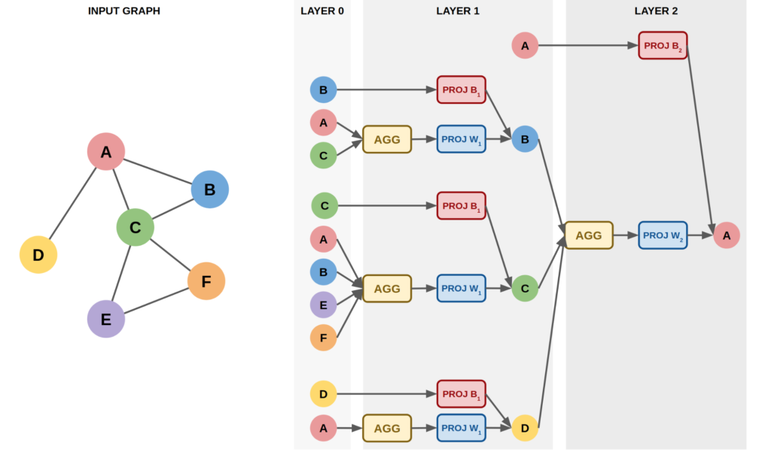
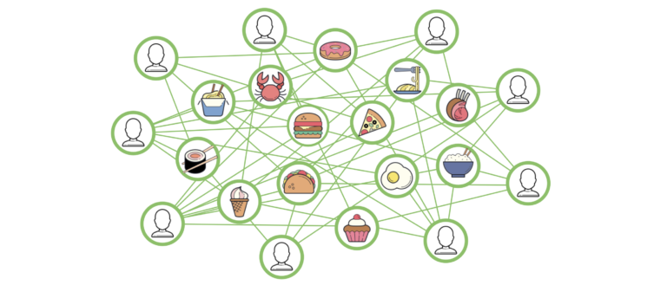
Recommending systems in Uber
Food Discovery with Uber Eats: Using Graph Learning to Power Recommendations

Slide 33
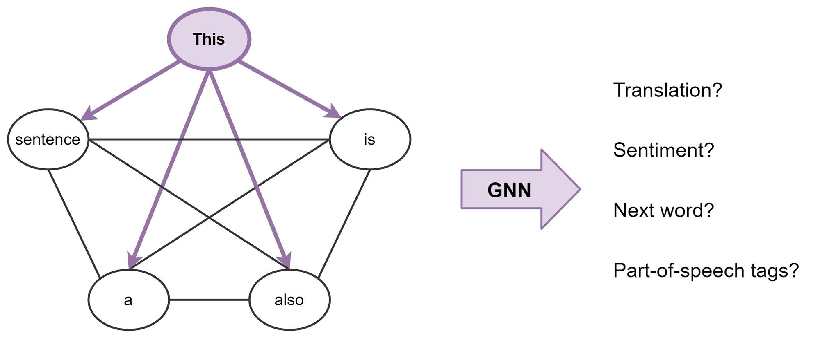
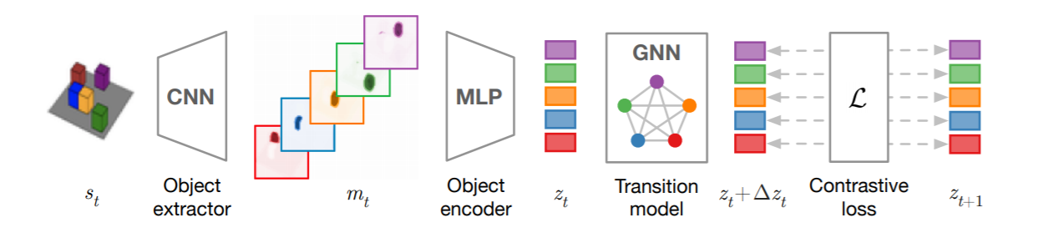
Graph networks in classic deep learning
[1911.12247] Contrastive Learning of Structured World Models
GNNs can be used to include relational reasoning in classical models!
Transformers are basically GNNs on fully-connected graphs!
https://thegradient.pub/transformers-are-graph-neural-networks/

Slide 34
Graph and learning
Open problems and challenges

Slide 35
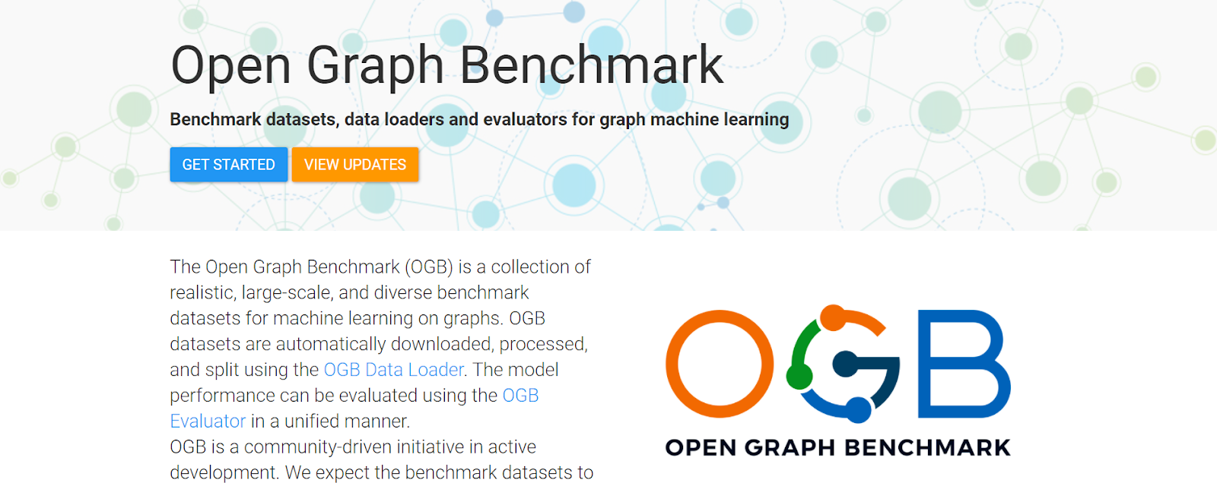
Scaling up to huge graphs
Notes:
The whole community is making an effort to design GNNs capable of scaling to massive datasets ( > 100M of nodes).
This is difficult for two main reasons:
First, a graph convolutional later to update a single node requires all its neighbours.
Furthermore, the number of neighbours grows exponentially with the number of layers. The only way to solve this problem is to move away from the standard message passing protocol.
The second reason is the lack of big opensource dataset. In fact, before 2021 it was almost impossible to tackle scaling for this reason.
This is partially solved thanks to "Open Graph Benchmark", a community-driven project that is currently releasing larger datasets.
However, these graphs lack of diversity. Something that works well on a citation's graph isn't optimal for a social network.
Because they have a different structure.
Similarly, what works on a molecular network doesn't necessarily work on a graph representing an energy grid.
GNNs have a lot of applications but, to be successful, we need more domain-specific datasets.

Slide 36
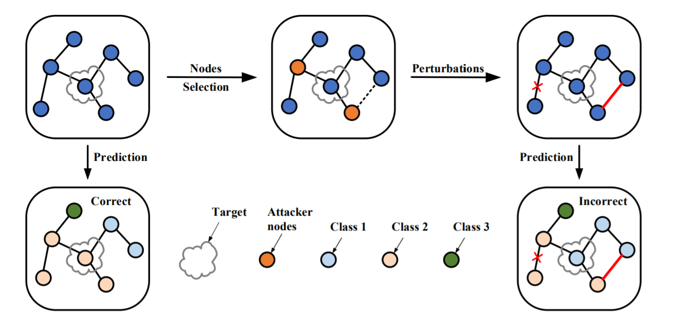
Robustness
Adversarial Attack on Large Scale Graph, https://github.com/safe-graph/graph-adversarial-learning-literature
Notes:
The following open problems are part of a broader field called Trustworthy machine learning.
The end goal here is the safe deployment of ML frameworks in the real world.
A model should be robust against adversarial perturbations.
You may be familiar with attacks on images that by changing the values of some pixels can change the image prediction.
However, we cannot apply these methods since images live in a continuous domain. Instead graphs are discrete.
However, attacking a GNN, even if more complex, it's far more interesting.
We have more possibilities:
* we can add or remove some edges
* change the attributes of some nodes
* or inject fake nodes into the graph.
We can also perform indirect attacks. This attack is interesting for a social network.
We can attack a target user by creating fake profiles and connecting them to the target's friends.
This attack can be used to misclassify the target's political orientation or to change its advertisement profile.
Crafting defense mechanisms its extreamely difficult due to the endless attacking possibilities.

Slide 37
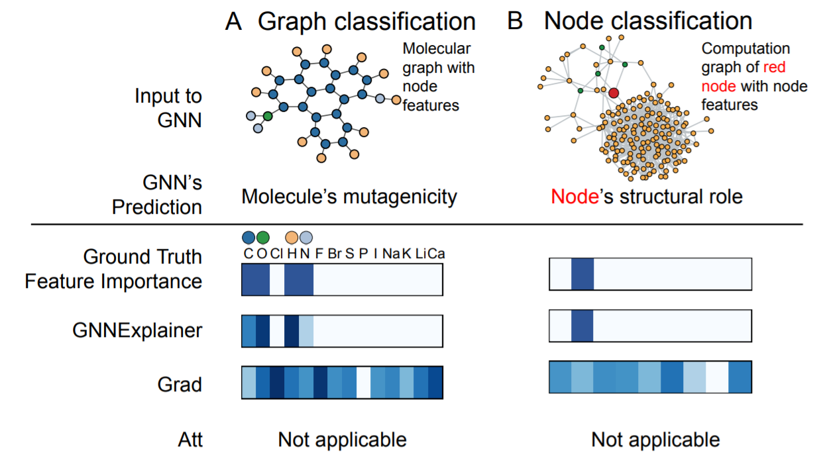
Interpretability
GNNExplainer (Ying et al., 2019)
Notes:
Interpretability is another big topic right now.
Here we want to understand the network's decision patterns and its systematic mistakes.
For example, we can highlight relevant connections or nodes features.
This is important for GNNs since they are widespread in computational biology.
Their results must be easy to interpret for the scientists using them to speed up their work.
But his holds for almost every real world application where the model should be easily interpreted by a human expert.

Slide 38

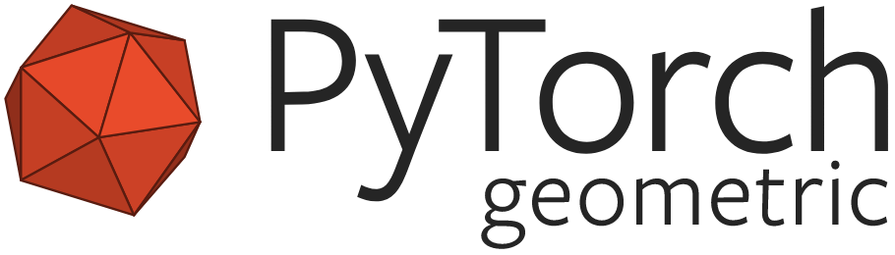

Software?
Amazon based, production-ready
PyTorch, more research oriented
Keras-like, TensorFlow 2.0
Notes:
If you want to implement a GNN you can choose between three software.
DGL is production-ready and supports both TensorFlow and PyTorch.
Pytorch geometric and Spektral are more research-oriented and frequently updated with the latest models.
In our experience both are very easy to use, especially Spektral.

Slide 39
Distributed graphs
When graphs go physical
Notes:
As a lab, we have worked a lot on distributed machine learning.
One way towards solving the scalability problem is by distributing both the data and the computation among different agents.
We believe that distributed GNNs and their application to cyber-physical systems like decentralized energy grid will be an exciting topic soon.

Slide 40
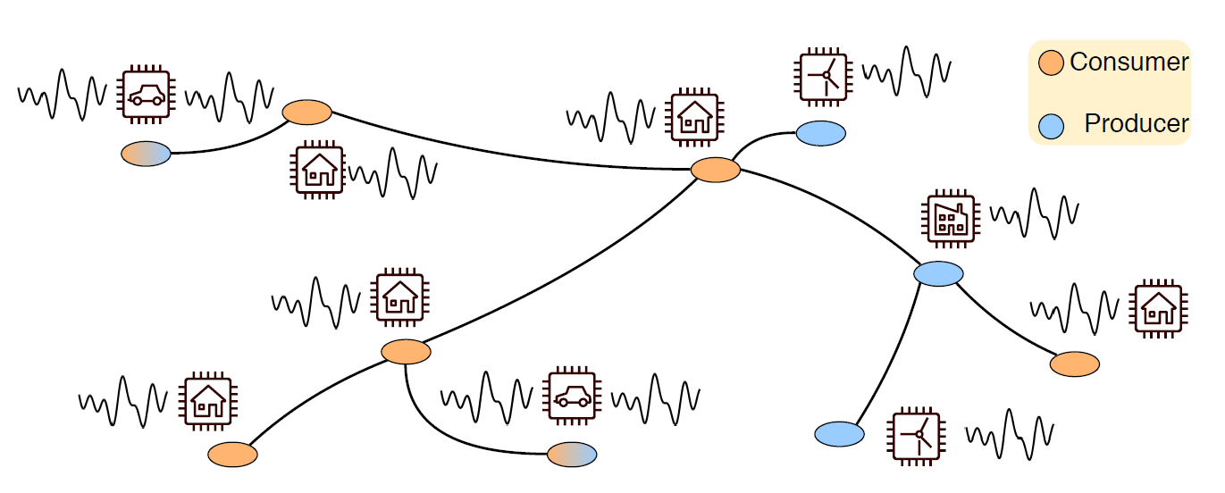
Distributed energy grids
What happens when our graph is also physically distributed?
Notes:
In this setting, we have multiple power generation sources located close to where electricity is used.
There are at least a dozen of problems for which a GNN is a perfect fit for this scenario.
For example:

Slide 41
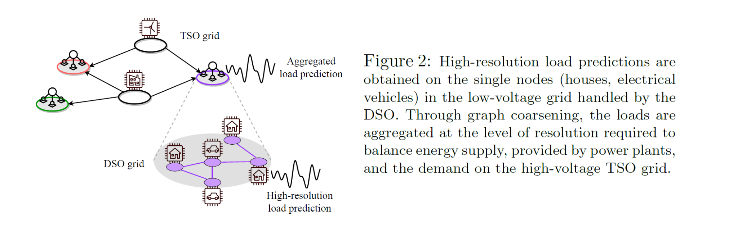
An example of application
Notes:
By setting a node regression task, we can predict the low-voltage demands of single nodes like houses and vehicles.
By pooling the graph and aggregating these demands, we can balance the high-voltage energy supply provided by the power plants.

Slide 42
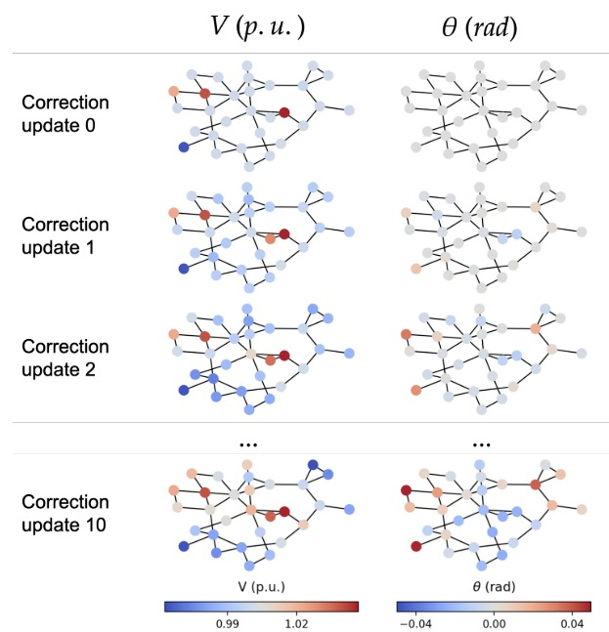
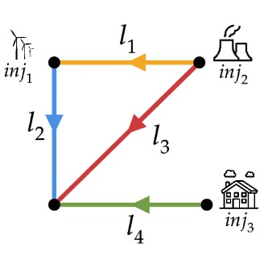
Another example
Donon, B., Donnot, B., Guyon, I. and Marot, A., 2019. Graph neural solver for power systems. In 2019 International Joint Conference on Neural Networks (IJCNN) (pp. 1-8). IEEE.
Notes:
Another example is the emulation Newton-Rapson solvers used for electricity flow calculation.
GNNs provides faster computations. In addition, once trained, they can be applied multiple times to different power grids with good results.
Instead, Newton-Rapson solvers are extremely slow and require a precise description of the grid.

Slide 43
Partially distributed graph networks
Local operation
✔️
Notes:
This kind of data is usually distributed across the different location. Each one of them storing a section of a very big gaph.
Therefore we need also a distributed graph algorithm.
As you have seen before, GNNs are already partially distributed due to the locality of the message passing protocol.

Slide 44
Partially distributed graph networks
“Shared weights”
❌
To implement in a fully decentralized fashion, nodes require perfect coordination.
Notes:
However, the weights are shared across the entire network.
If we want a fully decentralized model we have to coordinate the weights of the different agents storing the data during the training.

Slide 45

Fully distributed GCNs
Scardapane, S., Spinelli, I. and Di Lorenzo, P., 2020. Distributed Training of Graph Convolutional Networks. IEEE Transactions on Signal and Information Processing over Networks.
Notes:
For this reason, less then than six months ago, we crafted a procedure for training GNNs in a fully decentralized manner.
Both the inference step and the back propagation do not require a centralized controller.
Using a consensus protocol we coordinated the weights updates.

Slide 46

It works!
Nodes are traffic sensors in San Bernardino (California), with multiple base stations learning with no central coordination.
Scardapane, S., Spinelli, I. and Di Lorenzo, P., 2020. Distributed Training of Graph Convolutional Networks. IEEE Transactions on Signal and Information Processing over Networks.
Notes:
To validate our results, we used a traffic network dataset where multiple base station stored a subgraph of the traffic grid.
We performed our distributed training protocol and, as you can see, GNNs showed an advantage over more classic distributed alternatives.

Slide 47
Conclusions
Summarizing geometric deep learning

Slide 48
Key takeaways
Graph neural networks are powerful deep learning models that are surprisingly ubiquitous.
Scaling up and including temporal or heterogeneous information is challenging.
Huge research topic, still “under the radar” in industrial contexts.

Slide 49




Thanks for listening!
https://www.sscardapane.it/
https://spindro.github.io/
https://twitter.com/s_scardapane
https://twitter.com/IndroSpinelli
Simone Scardapane Assistant Professor
Indro Spinelli PhD Student
BTW, check out our association:
Italian Association for Machine Learning
And why not our podcast?
Smarter Podcast
💬
🎙️

